Slide 1
E-Commerce Sales Tableau

Slide 2
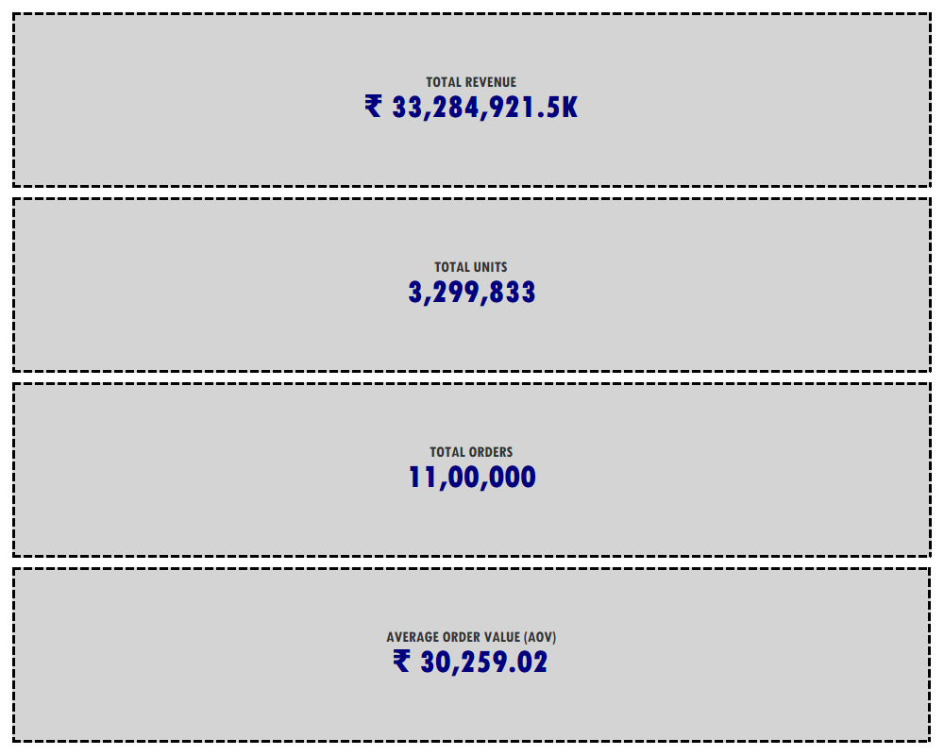

Slide 3
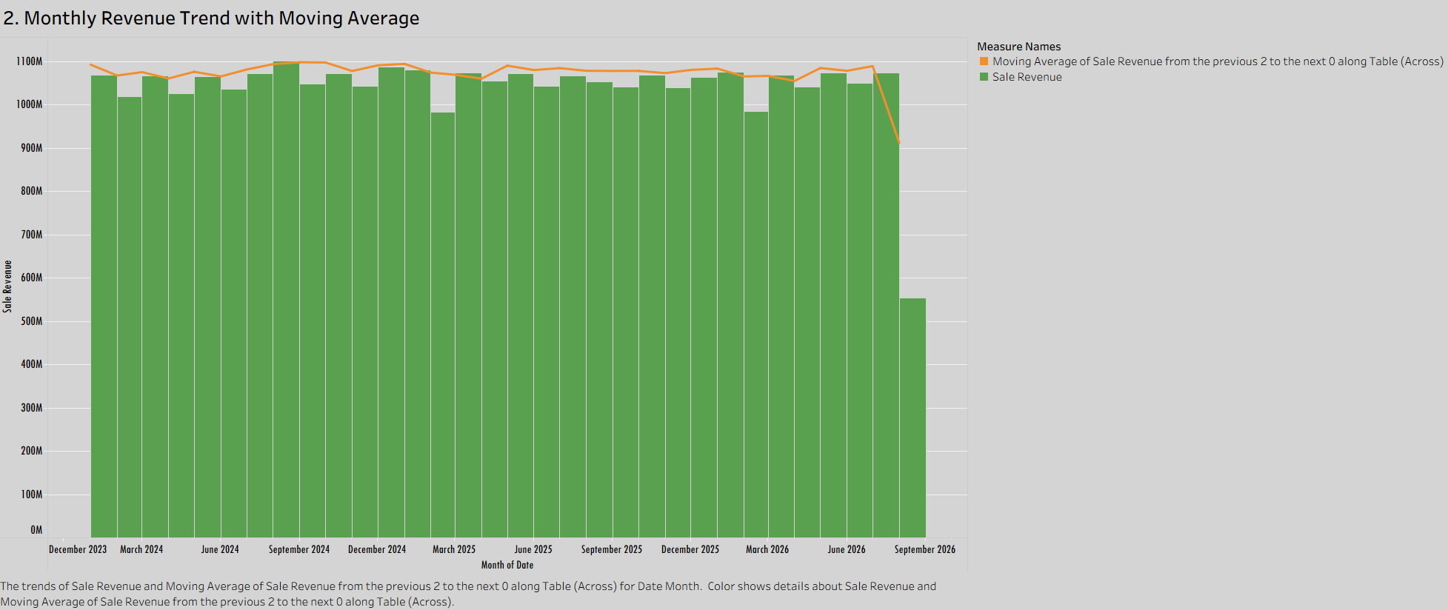

Slide 4
Stable Core Revenue: Maintained a steady monthly revenue baseline averaging ~₹1,060M (₹106 Cr) between Dec 2023 and Aug 2026.
Top Sales Month: Reached peak performance in September 2024 (₹1,100M/₹110 Cr), driven by strong end-of-Q3 sales.
Low Trend Volatility: The 3-month moving average confirms consistent recurring demand with minimal quarter-over-quarter fluctuation.
Active Month Partial Data: September 2026 reflects in-progress data collection, accounting for the lower visible bar.

Slide 5
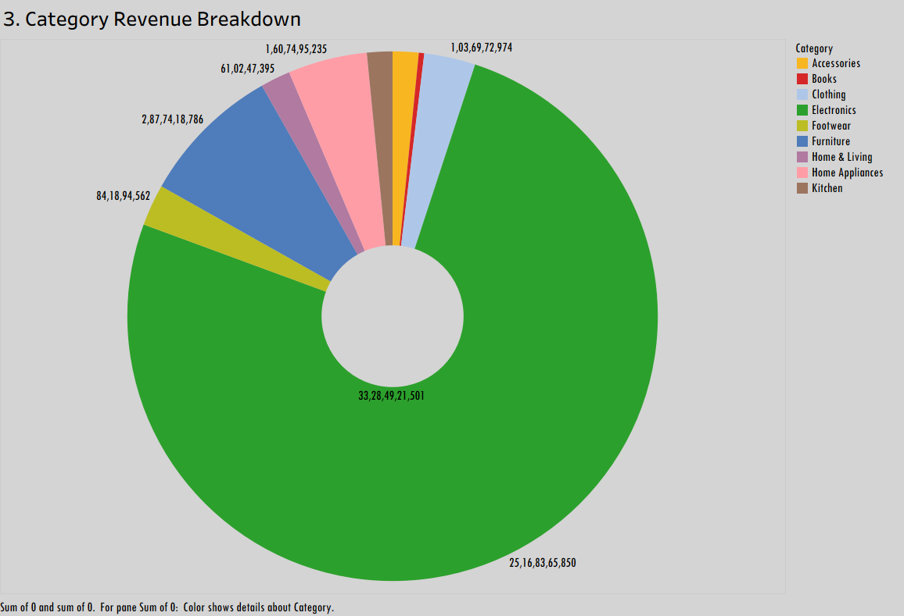

Slide 6
Heavy Revenue Concentration: Electronics commands the overwhelming majority of total business revenue at ₹2,516.8 Cr (₹25,16,83,65,850).
Top 3 Core Revenue Pillars: Electronics, Furniture (₹287.7 Cr), and Home Appliances (₹160.7 Cr) collectively form the core financial engine of the business.
Long-Tail Optimization: Clothing, Footwear, and Home & Living generate steady mid-tier returns, while Books, Kitchen, and Accessories present opportunities for cross-selling expansion.
Total Ecosystem Sales: Overall sales revenue across all categories stand at ₹3,328.5 Cr (₹33,28,49,21,501).

Slide 7
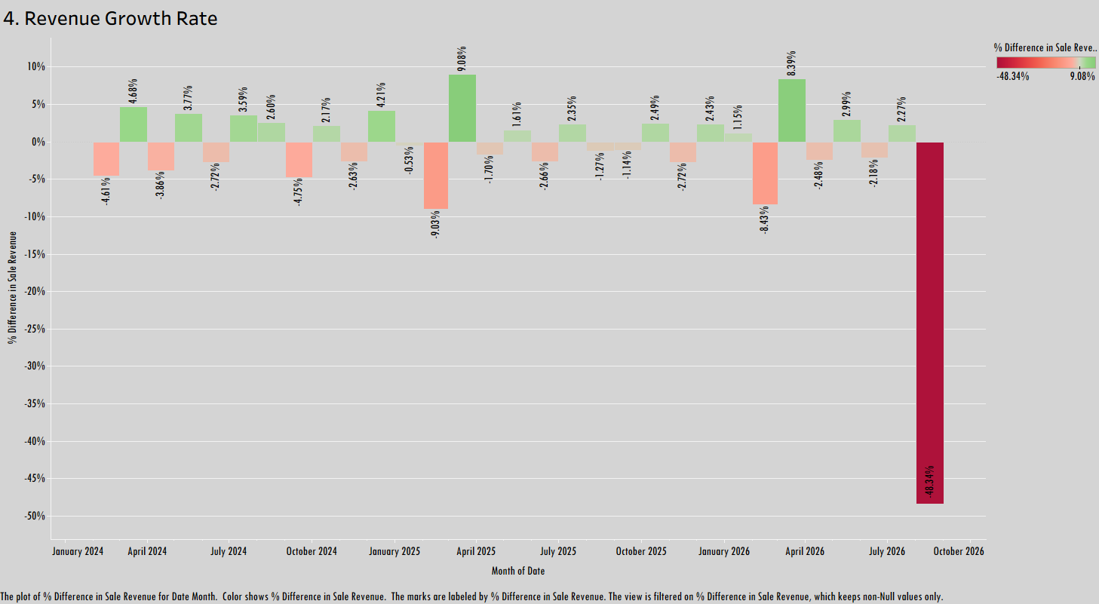

Slide 8
Peak Growth Performance: Achieved maximum MoM revenue expansion in February 2025 (+9.08%) and February 2026 (+8.39%).
Steady Volatility Range: Baseline month-over-month growth fluctuates within a healthy, predictable band of -4.75% to +4.68%.
Seasonal Recovers: Sharp pullbacks (such as -9.03% in early 2025) are consistently followed by immediate, high-volume growth rebounds.
Active Month Partial Reporting: August 2026 reflects -48.34% due to in-progress data collection for the current cycle.

Slide 9
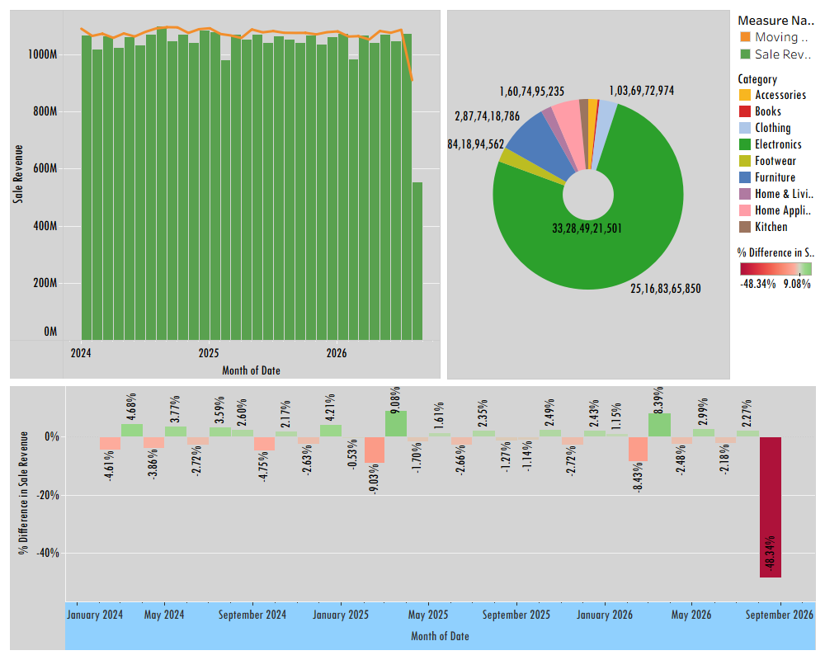

Slide 10
Robust Financial Baseline: Achieved total revenue of ₹3,328.5 Cr, driven by steady monthly revenue averaging ~₹106 Cr between Dec 2023 and Aug 2026.
Electronics-Driven Portfolio: Electronics leads overall performance at ₹2,516.8 Cr, with Furniture and Home Appliances forming the remaining core revenue pillars.
Q2 Expansion & Peak Sales: Record monthly sales reached ₹110 Cr in Aug 2024, with March consistently generating top MoM growth rates (+9.08% in 2025, +8.39% in 2026).
Predictable MoM Growth: Baseline month-over-month revenue performance fluctuates safely between -4.75% and +4.68%, demonstrating high stability.

Slide 11
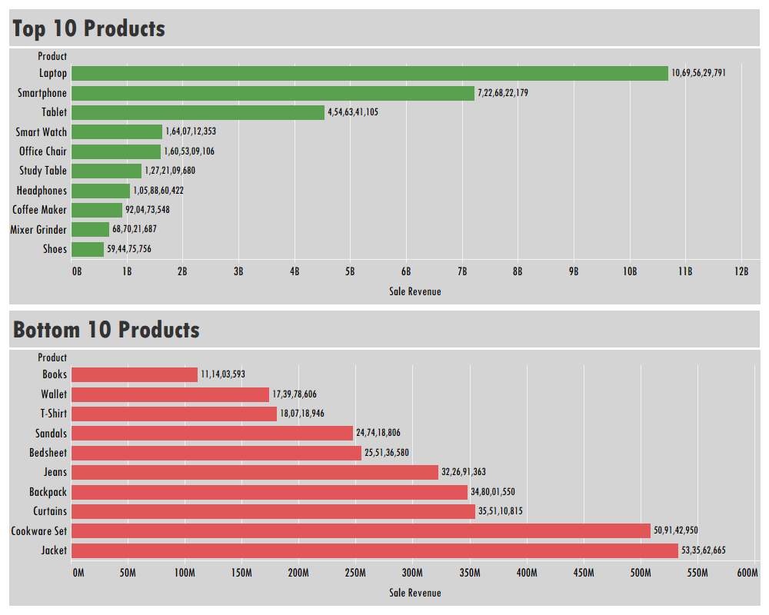

Slide 12
Dominant Flagship Item: Laptop leads all product sales at ₹1,069.6 Cr, generating more revenue than the bottom 10 products combined.
Tech-Centric Revenue Top 4: High-ticket consumer electronics (Laptops, Smartphones, Tablets, Smart Watches) drive the vast majority of catalog sales revenue.
Lowest Revenue Tier: Books represents the lowest-grossing product at ₹11.1 Cr, followed by low-ticket apparel and accessories like Wallets (₹17.4 Cr) and T-shirts (₹18.1 Cr).
Catalog Rebalancing Opportunity: Low-revenue items like Books, Wallets, and T-shirts require targeted bundled promotions or pricing adjustments to boost basket size.

Slide 13
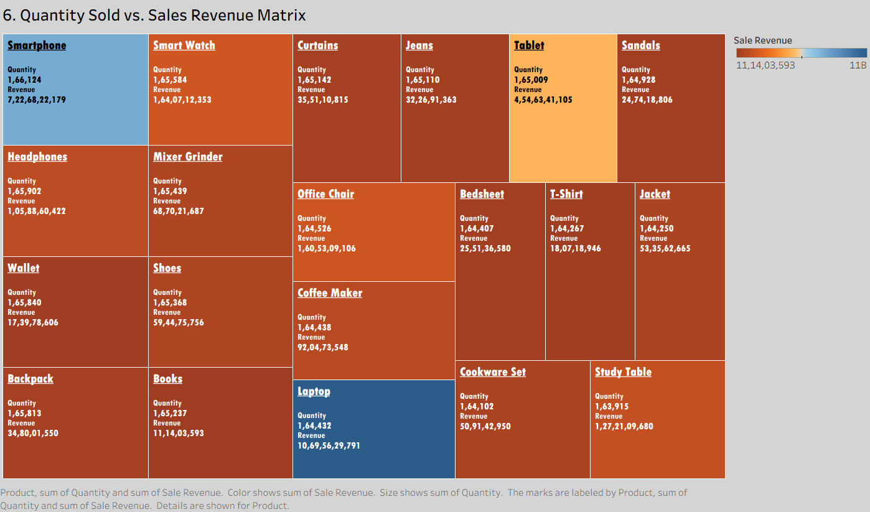

Slide 14
Uniform Demand Distribution: All 20+ products maintain tight unit volume consistency between ~1.64L and 1.66L units sold.
Revenue Driven by Pricing Strategy: Laptop leads revenue at ₹1,069.6 Cr, generating over 96x more sales value than Books (₹11.1 Cr) despite nearly equal unit movement.
High-Volume, Low-Margin Products: Books, Wallets, and T-shirts absorb high logistical handling (1.65L+ units each) while contributing less than ₹20 Cr each to total revenue.
Strategic Optimization: Focus on upselling and bundling low-ticket items (Books/Apparel) with high-ticket electronics (Laptops/Smartphones) to maximize average order value.

Slide 15
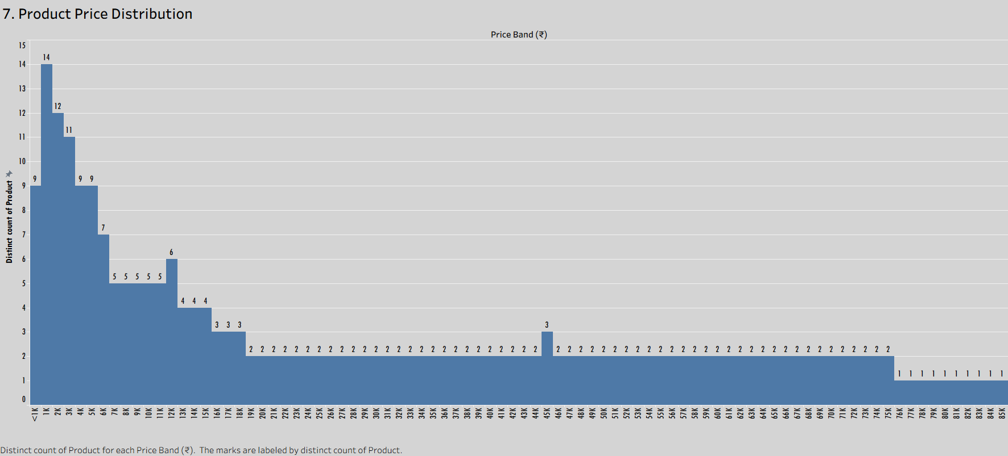

Slide 16
Low-Ticket Inventory Dominance: The product portfolio is concentrated in entry-level pricing, with the <₹1K price band leading at 14 distinct products.
Rapid Catalog Tapering: Over 60% of distinct catalog products are priced below ₹10K, showing steep decline as price points increase.
Stable Mid-Tier Pricing: Product variety plateaus evenly between ₹16K and ₹45K with 2-3 products per price bin.
Sparse Premium Tier: High-ticket products above ₹75K are ultra-focused, consisting of only 1 flagship product per price bin (driving high revenue despite low price variety).

Slide 17
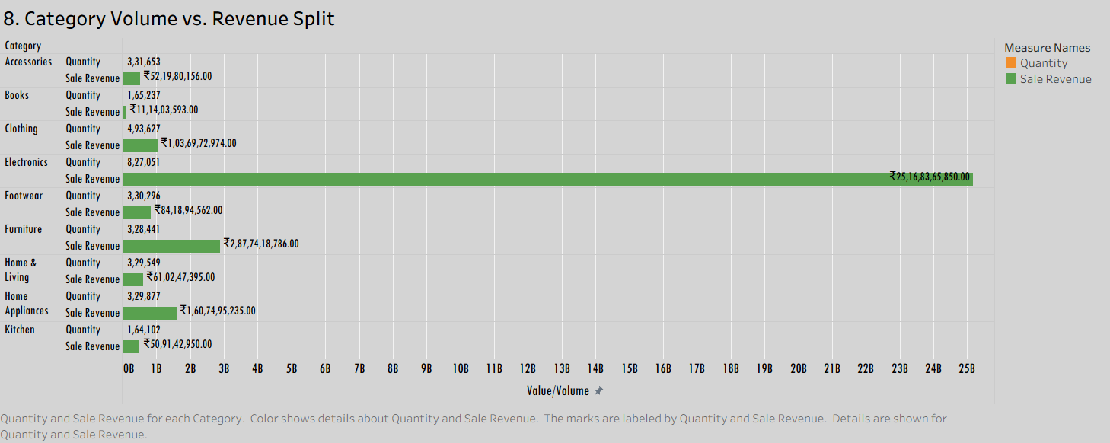

Slide 18
Electronics Dominates Scale: Leads both volume and value, contributing 8.27 Lakh units sold and ₹2,516.8 Cr in total sales revenue.
High Volume vs. Low Monetization: Clothing achieves the second highest volume (4.94 lakh units), but lower pricing yields just ₹103.7 Cr in total revenue.
Consistent Volume Plateau: Five core categories (Footwear, Furniture, Home Appliances, Home & Living, Accessories) each maintain steady volume around ~3.3 Lakh units.
High Unit-Value Return: Furniture generates ₹287.7 Cr on 3.28 Lakh units, making it the second most lucrative revenue generator despite moderates sales volume.

Slide 19
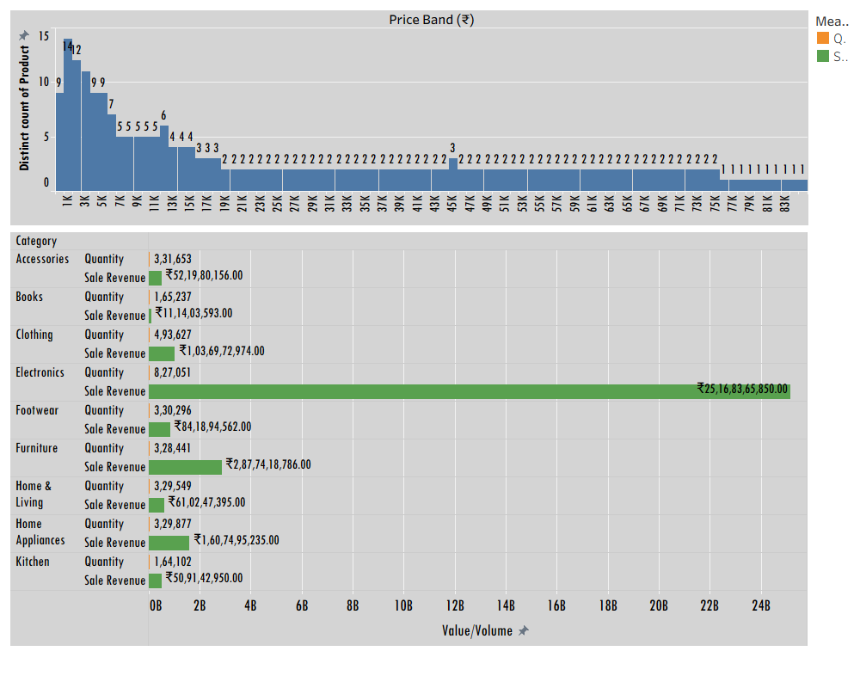

Slide 20
Entry-Level Product Concentration: Catalog variety is heavily concentrated in low-ticket items, led by 14 distinct products under ₹1,000 and over 60% of items under ₹10,000.
Electrons Drives Strategic Value: High-ticket inventory (₹46K-₹85K+) maintains low product variety (1-2 products per bin) but powers Electronics to lead overall performance at ₹2,516.8 Cr.
Volume vs. Revenue Mismatch: Fast-moving consumer categories like Clothing (4.94L units) generate substantial order volume but lower revenue (₹103.7 Cr) due to low-bin price concentration.4
Balanced Mid-Tier Margin Strategy: Categories priced within the ₹16K-₹45K mid-tier plateau deliver optimal revenue per unit sold.

Slide 21
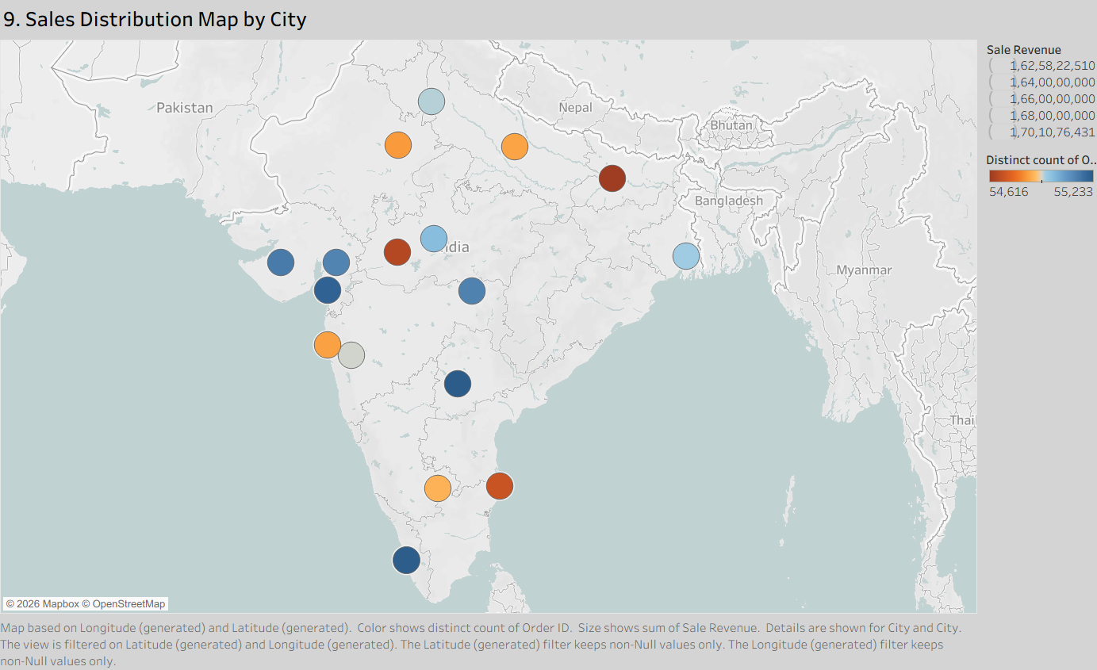

Slide 22
Uniform Geographical Performance: Sales revenue across all target cities stays tightly grouped between ₹162.6 Cr and ₹170.1 Cr.
Consistent Demand Across Cities: Distinct order counts per city remain virtually even, spanning 54.6K to 55.2K orders per region.
Balanced Pan-India Footprint: Revenue generation is well distributed across Northern, Western, Southern, and Eastern urban clusters without over-reliance on a single metropolitan market.
Logistics & Inventory Efficiency: Equal volume movement across cities allows for standardized regional warehouse stocking and fulfillment planning.

Slide 23
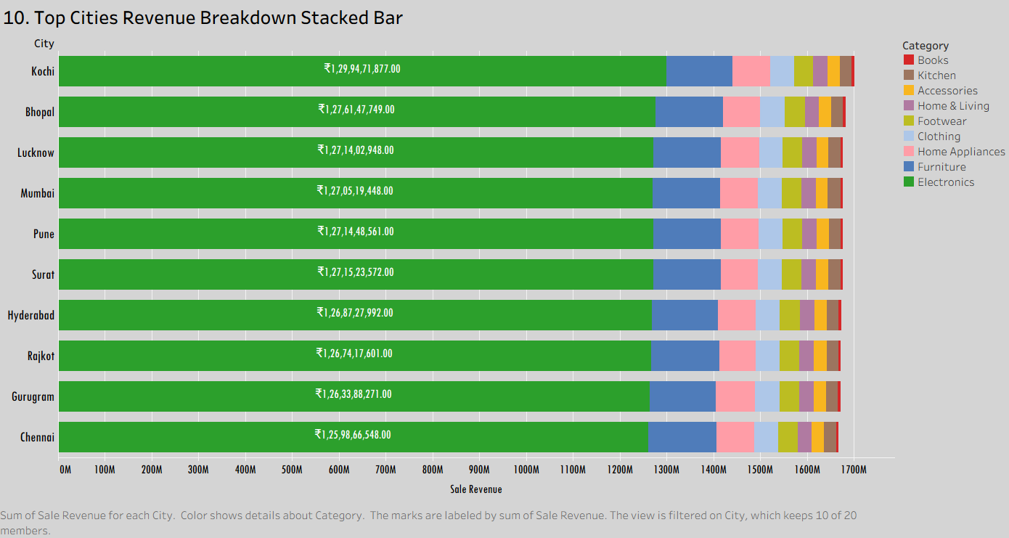

Slide 24
Uniform Revenue Distribution: Top 10 cities deliver virtually identical total revenue, led by Kochi at ₹129.9 Cr and bounded by Chennai at ₹126.0 Cr.
Electronics Overwhelmingly Leads: Electronics accounts for over 75% of total city revenue across all top markets, driving ~₹1,250 Cr+ per city.
Equally Performing Metro & Tier-2 Markets: Non-metro regional centers (Kochi, Bhopal, Lucknow, Surat, Rajkot) generate equal or higher revenue compared to major metros (Mumbai, Hyderabad, Chennai).
Consistent Cross-Category Demand: Non-electronic categories exhibit an identical category split in every city, proving that customer demand patterns are uniform across geographic markets.

Slide 25
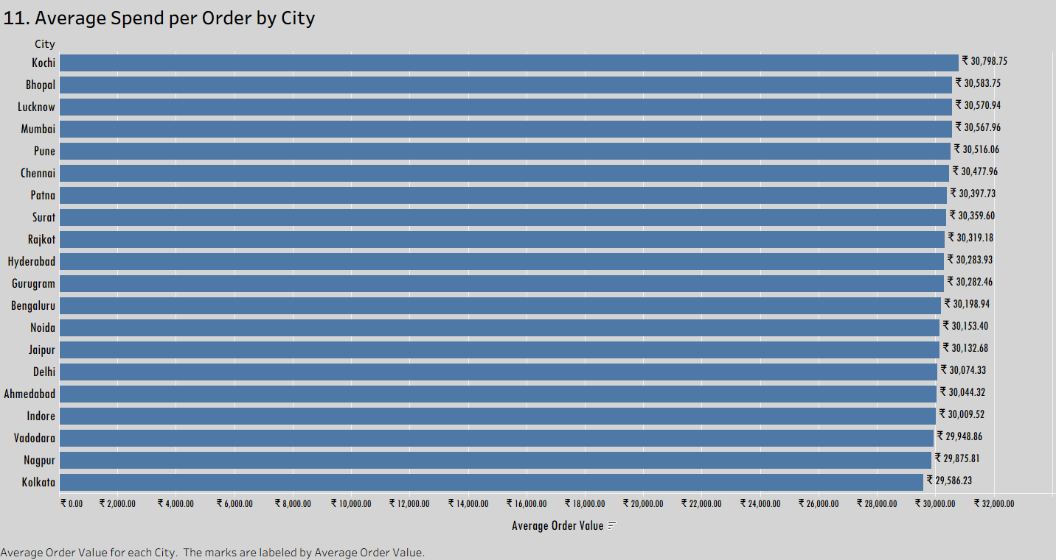

Slide 26
High Uniformity in Order Value: Average order spend per city stays extraordinarily flat across India, holding tightly between ₹29.5K and ₹30.8K.
Tier-2 Markets Outpace Major Metros in AOV: Kochi (₹30,798), Bhopal (₹30,584), and Lucknow (₹30,571) outrank key metro hubs like Delhi, Bengaluru, and Hyderabad in average ticket size.
Nationwide Revenue Consistency: Purchasing power per transaction remains uniform regardless of region, city tier, or geographical cluster.
Standardized Pricing & Promotional Strategy: Consistent AOV across all 20 cities allows for uniform pricing, bundling, and minimum order threshold policies across the entire network.

Slide 27
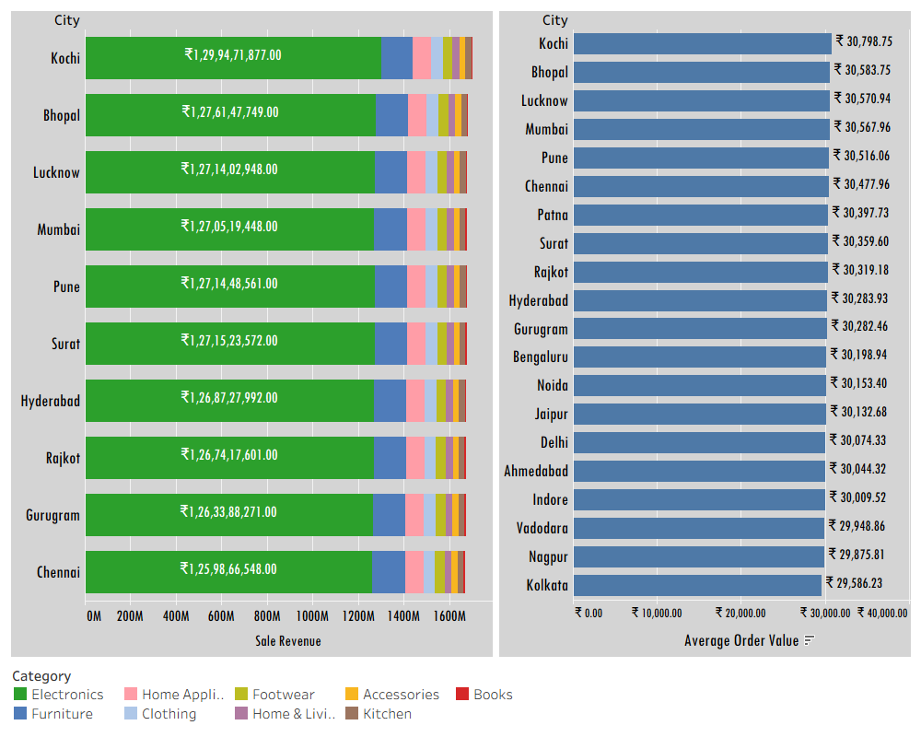

Slide 28
High Geographical Market Consistency: Top city sales range tightly between ₹126.0 Cr (Chennai) and ₹129.9 Cr (Kochi), while Average Order Value (AOV) spans ₹29.5K to ₹30.8K nationwide.
Tier-2 Urban Hubs Lead Performance: Non-metro markets like Kochi (₹30,799 AOV), Bhopal (₹30,584 AOV), and Lucknow (₹30,571 AOV) match or exceed top metros (Mumbai, Delhi, Bengaluru) in spend per transaction.
Electronics Powered Growth: Electronics generates over 75% of total city revenue across top markets, driving over ₹1,250 Cr per city.
Standardized Pricing & Supply Chain Operations: Uniform purchasing behavior across all regions allows for nationwide fulfillment strategies, centralized inventory planning, and standardized promotional pricing.

Slide 29
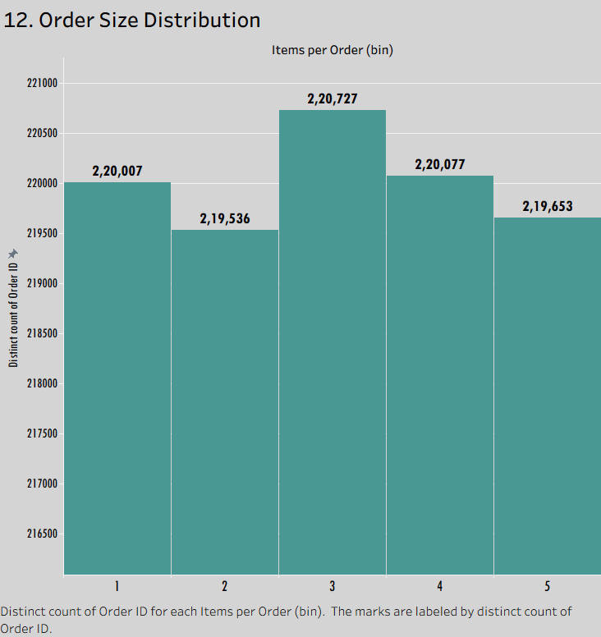

Slide 30
Near-Equal Order Volume Across Basket Sizes: Total order count is evenly distributed across 1 to 5 items per order, holding steadily at ~2.2 Lakh orders per bin.
Peak Demand at 3 Items per Order: Orders containing 3 items form the largest individual volume bin at 2,20,727 distinct orders.
Strong Standalone & Multi-Item Demand: Single-item purchases (2,20,007 orders) match 4-item purchases (2,20,077 orders) nearly 1:1 in total volume.
Consistent Packaging & Fulfillment Load: Low variance across order sizes (~0.5% difference between top and bottom bins) supports standardized warehouse packing processes and predictable shipping materials management.

Slide 31
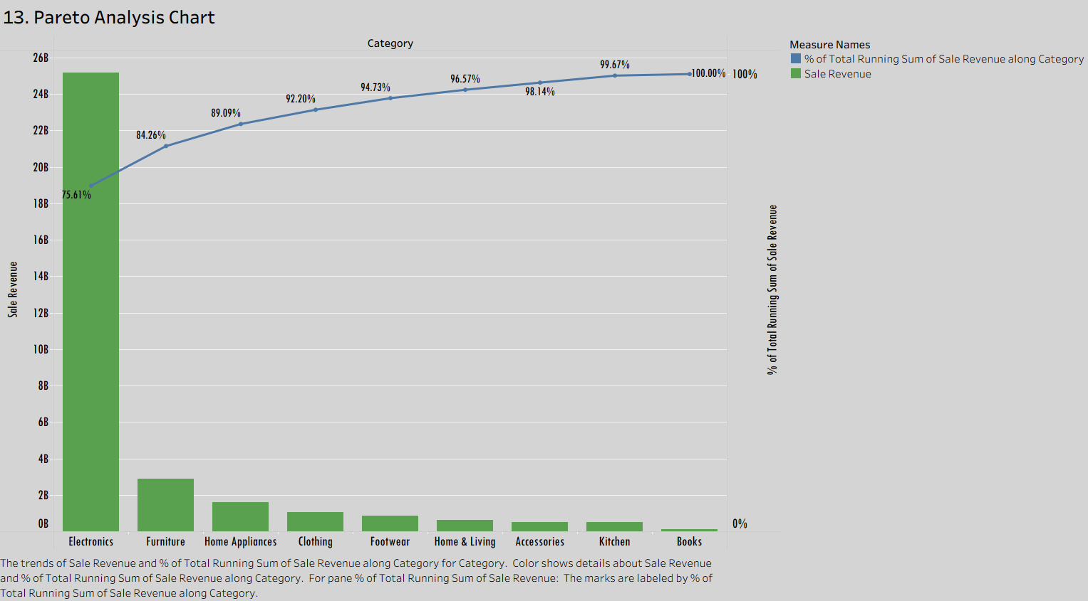

Slide 32
Electronics Drives The Core Business: Electronics alone accounts for 75.61% of total cumulative sale revenue, exceeding ₹25B (₹2,500 Cr+).
80/20 Revenue Concentration: The top two categories–Electronics and Furniture–combine to generate 84.26% of overall revenue.
Top 3 Categories Reach ~90% Share: Adding Home Appliances brings total cumulative revenue contribution to 89.09%.
Strategic Focus Area: Resource allocation, inventory investment, and marketing strategies should remain heavily focused on Electronics, Furniture, and Home Appliances to protect ~90% of business revenue.

Slide 33
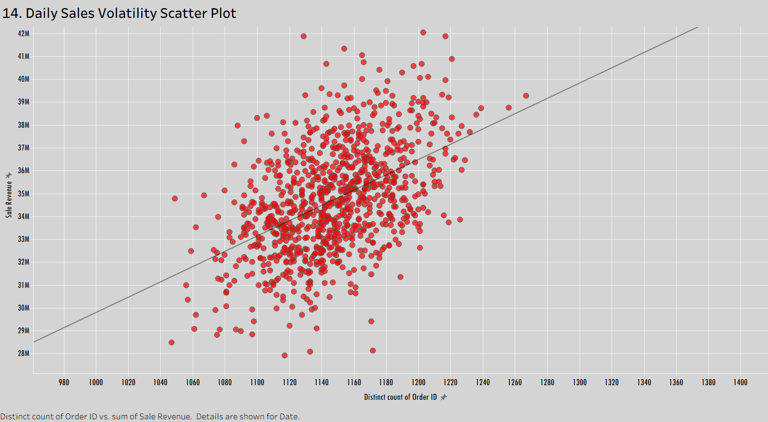

Slide 34
Linear Volume-to-Revenue Growth: Daily sales revenue increases predictably alongside daily order counts, following a strong positive trend line.
Tight Daily Volume Clustering: Standard business operations consistently process between 1,080 and 1,220 orders per day.
Widely Revenue Spread per Volume Tier: Daily sales revenue varies between ₹2.8 Cr and ₹4.2 Cr at equal order volumes, driven by variation in basket composition and high-ticket item sales.
Peak Revenue Multipliers: Exceptional sales days peak above ₹4.2 Cr in daily revenue, demonstrating high upside potential on high-ticket sales days.

Slide 35
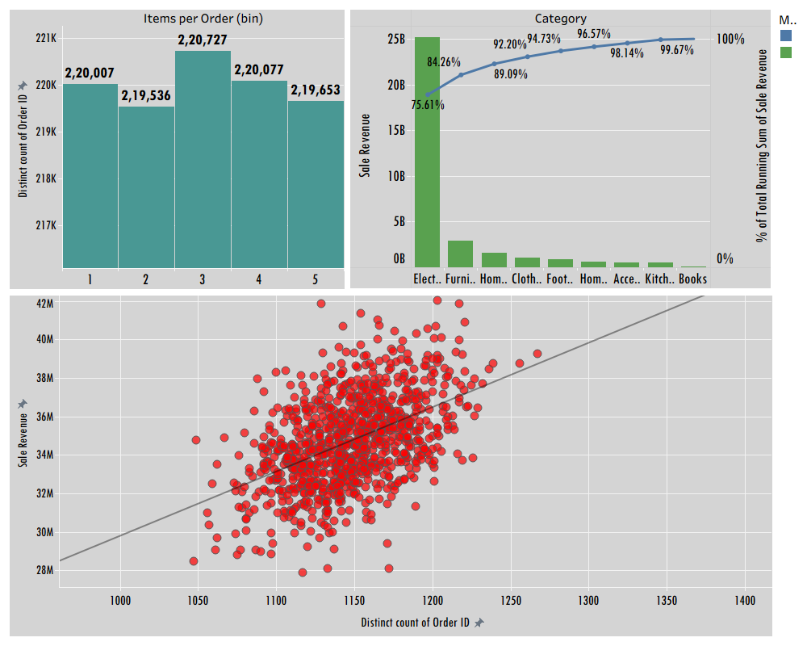

Slide 36
Standardized Customer Order Volumes: Total order distribution spans tightly between 2.19 Lakh and 2.20 Lakh orders across all 1-to-5 item basket bins, peaking at 3 items per order (2,20,27 orders).
Core revenue Anchored by Electronics: Electronics accounts for 75.61% of cumulative sales revenue (>₹25 Billion / ₹2,500 Cr+), while the top 3 categories (Electronics, Furniture, and Home Appliances) combine for 89.09% of total revenue.
Linear Daily Revenue Trajectory: Daily sales revenue correlates directly with order count along a strong positive trend line, with regular business operations processing 1,080 to 1,220 orders per day.
Daily Basket Mix Drives Revenue Spikes: Daily revenue fluctuates by up to ₹1.4 Cr at constant daily order volumes, demonstrating that high-ticket item sales (Electronics) are the primary engine for peak revenue days (₹4.2 Cr+).

